Slide 1

Learning
Shashank Saumya
and
Abhishek Anil Deshmukh
Under
Subhankar Mishra

Slide 2
Overview:
Types of Learning
Inductive Learning
Examples of learning:
Taxonomy
Basketball
Iris Flower
Stock Market Prediction

Slide 3
Types of learning:
Deductive learning
Inductive learning
Transductive learning

Slide 4
Deductive learning
The problem has been solved.
There are set of rules.
The answer is obtained with a 100% accuracy using those rules.

Slide 5
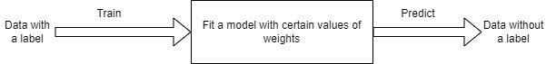
Inductive Learning
It is a concept of learning.
Try to fit a general rule from a set of observed instances.
Try to fit a model based on the known. Then use that model to predict the unknown.
Is dynamic and easily adapt to new data.
Inductive Learning algorithm
Notes:
Contrast with deductive learning.

Slide 6

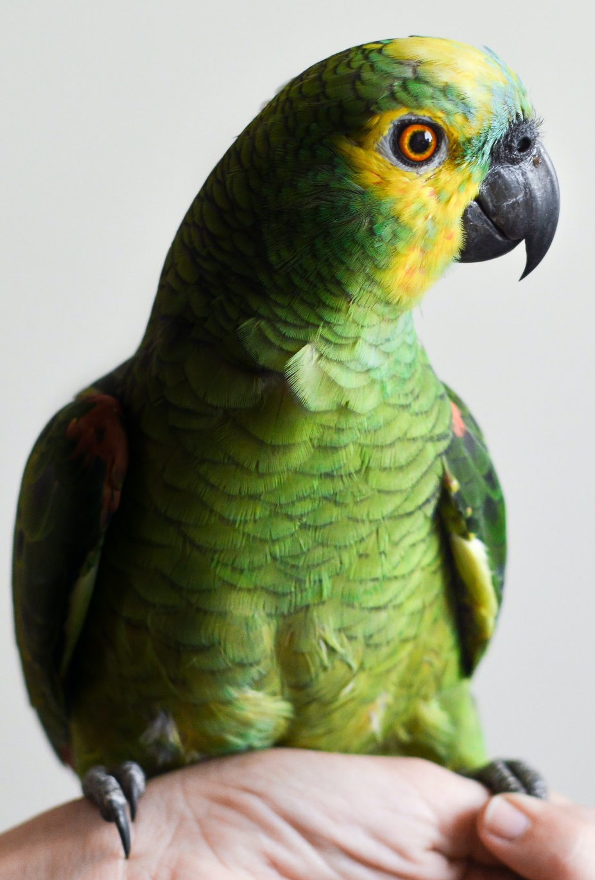



Taxonomy
Taxonomical ranks: Kingdom, Phylla, class, order, etc
Look at features to classify the organisms.
There are more than one ways to group them.
Bird
Parrot
Cat
Lion
Grass

Slide 7

Example: Deciding if a player is good at basketball
You are given a data of students with
columns like height, grades, age, etc.
Trend in data.
Fit a model.
Predict another student.

Slide 8
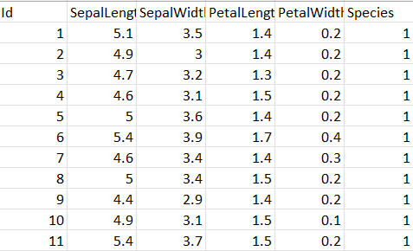
Using perceptron to distinguish between different types of irises
The dataset has attributes for flowers known as iris.
The data has 3 different types of species, 1 of the species is linearly separable from the other two.
Iris Dataset

Slide 9
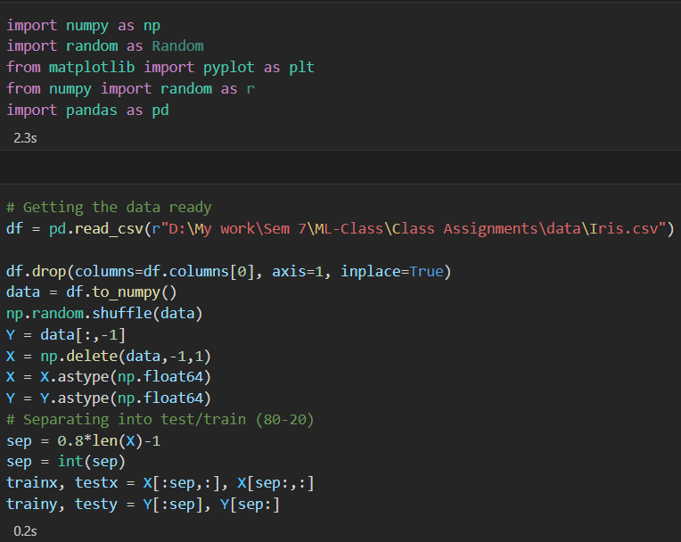
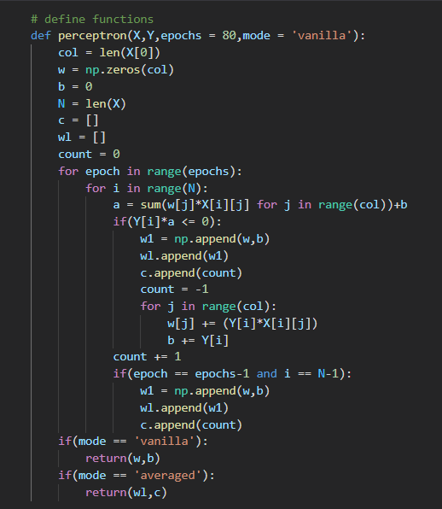
Code:

Slide 10
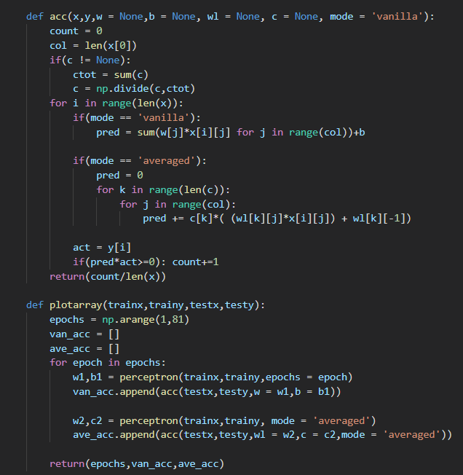
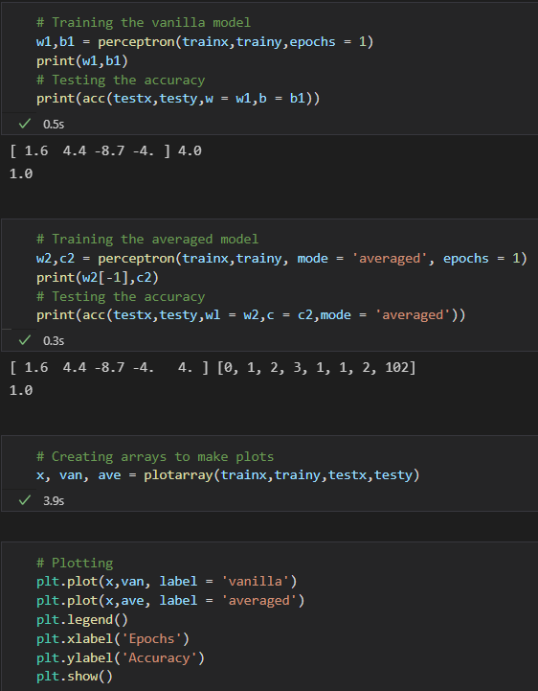
Code:

Slide 11
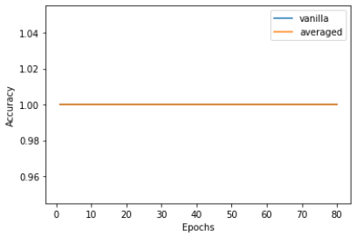
Result:
Accuracy vs epoch

Slide 12
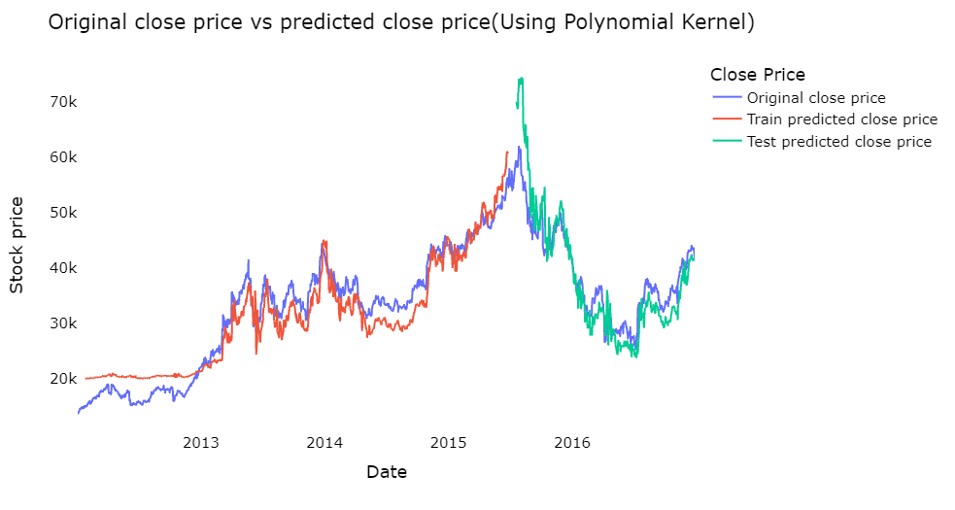
Stock Market Prediction
Stock Prediction using SVR model.
Results of stock market value prediction using SVR
Notes:
UNIQLO stock value prediction

Slide 13
When to use
Problems which cannot be solved deductively.
Problems in which no human expertise is available.
Humans can complete the task, but it is difficult for a computer.
Problems where the desired function is frequently changing.
Problems where each user requires a unique function.
Notes:
If no one knows, let the machine find a pattern.
Driving a vehicle
Stock Market
Ad recommendations

Slide 14
References:
Model Algorithm drawing drawn using draw.io
Taxonomy and basketball slide images are stock, free to use images taken from www.pexels.com
Iris dataset Link:- https://archive.ics.uci.edu/ml/datasets/Iris
Perceptron images are from my class assignment.
SVR Stock market project link:- https://www.niser.ac.in/~smishra/teach/cs460/2021/project/21cs460_group10/

